Slide 1

MTN Nigeria Customer
Churn & Usage (2025)
July 2025

Slide 2
Study Objectives
Identify Key Drivers of Customer Churn
01
02
Analyze Customer Churn by Demographics
Evaluate Device-Based Customer Satisfaction
03
Examine Revenue Contribution by Device Type
04

Slide 3
“
Customer churn is one of the biggest concerns for telecom companies, especially in competitive markets like Nigeria. This dataset simulates the behaviour, preferences, and churn patterns of MTN Nigeria customers in Q1 2025. It provides rich insight into device usage, data plan preferences, age groups, tenure, churn drivers, and revenue patterns.

Slide 4




Requirement Gathering:
Understand business goals, Define KPIs,
Data access and permissions
Data Cleaning:
Use Power Query for shaping, Remove duplicates, nulls, standardize formats
Data Modelling:
Use DAX for calculated
columns and measures
Dashboard Design:
Selection of appropriate charts and visuals

Slide 5
Percentage of churned customers
High Call
Tariffs
Highest Reason
for Churn
29.16%
Highest Churned Age Group
Adults

Slide 6
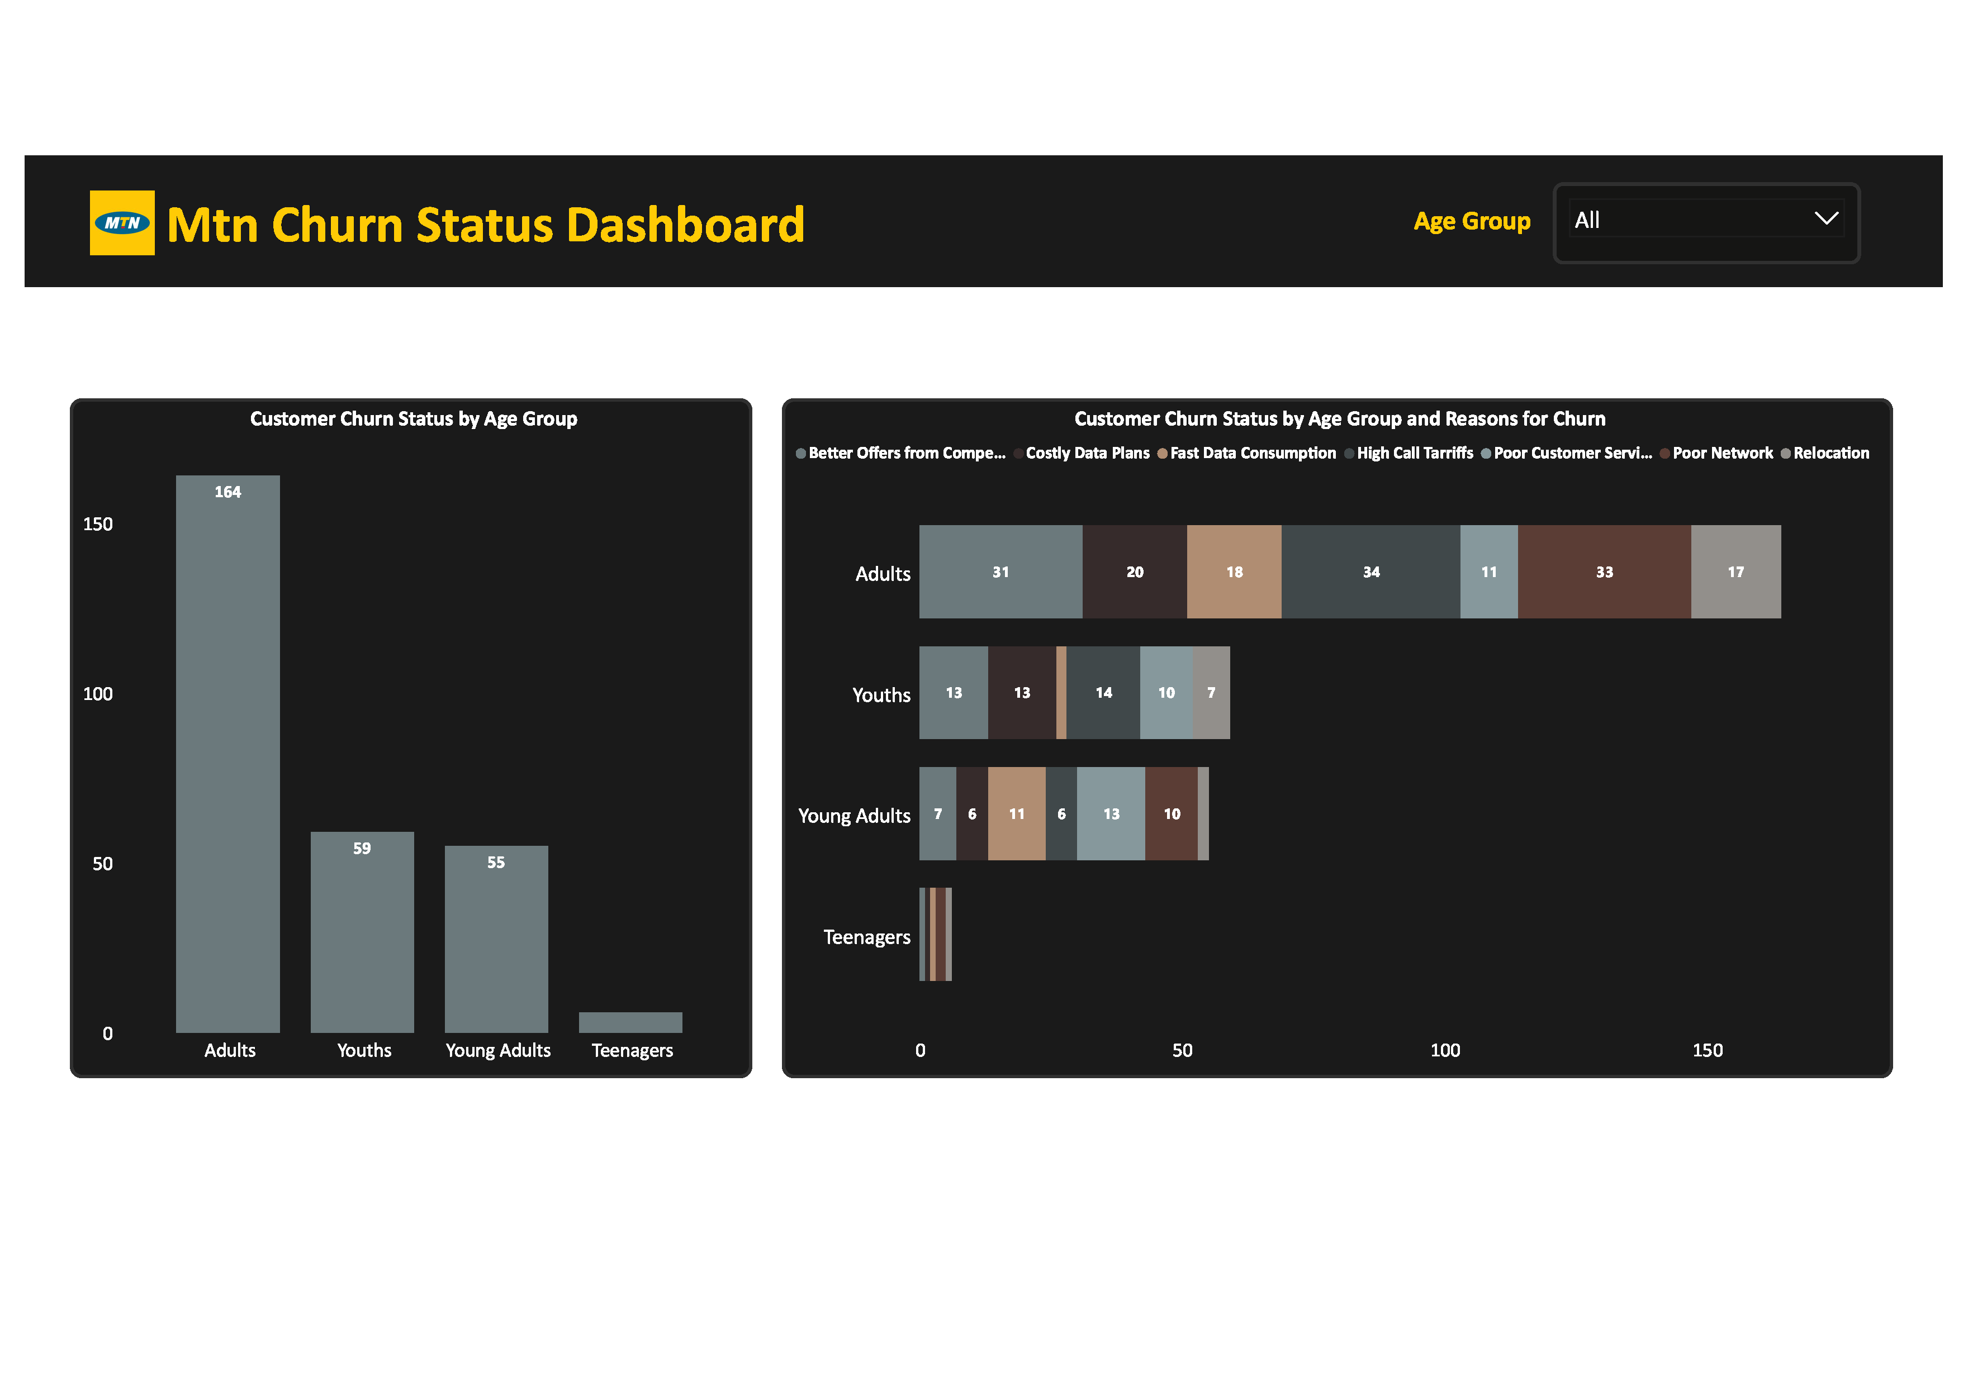
Adults have been identified to be the highest churn age group

Slide 7
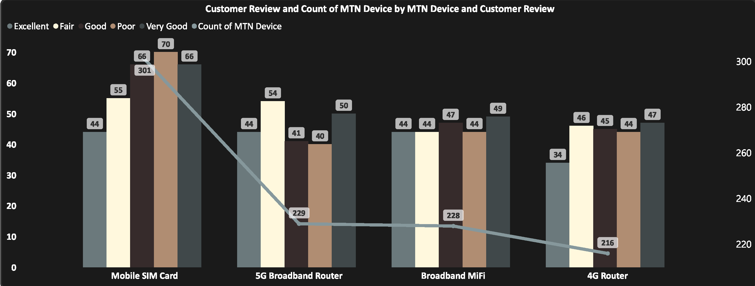
High SIM card purchases might stem from historical usage and accessibility, but they correlate with the highest churn level and as well high poor rating.

Slide 8
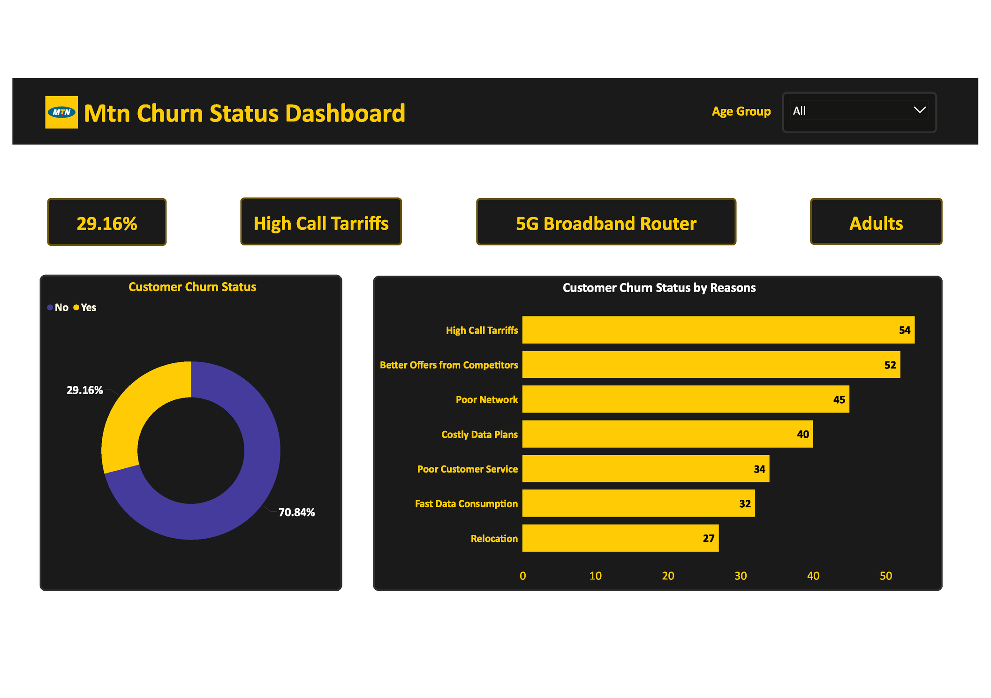
High call tariffs revealed as the most significant driver of churn.

Slide 9

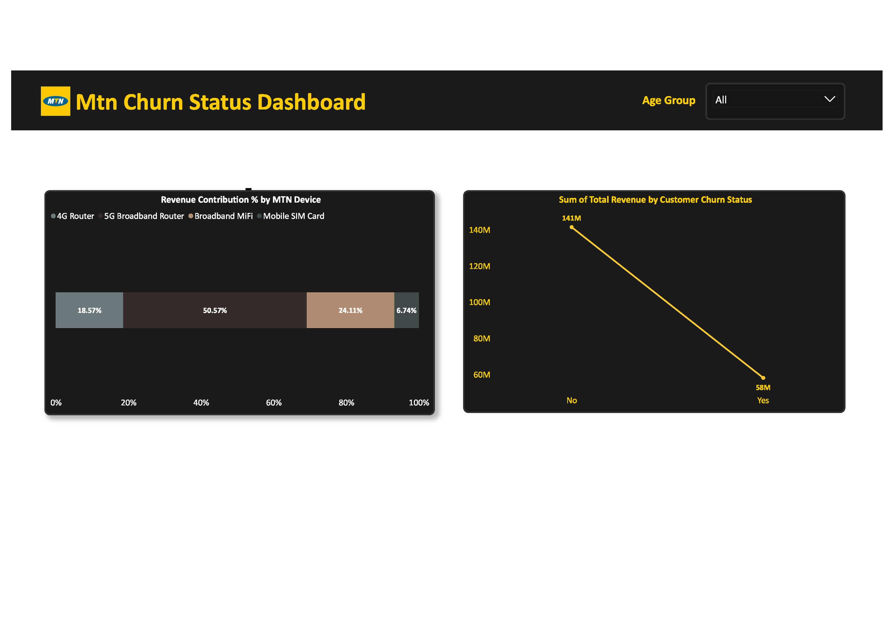
5G Broadband Routers: Account for 50.57% of revenue, highlighting high unit value and potential customer satisfaction with premium services
5G Broadband Routers: Account for 50.57% of revenue, highlighting high unit value and potential customer satisfaction with premium services.
Mobile SIM Cards: Lowest revenue contribution, possibly due to low cost per unit and mass adoption over time.

Slide 10
Strategic Recommendations to Reduce Churn
High call tariffs are directly tied to customer churn. A reassessment of pricing models or bundling offers may reduce churn.
Focus on promoting higher-revenue devices like 5G routers, which are more lucrative despite lower purchase frequency.
Consider upselling SIM customers to router-based products or bundling solutions.
Competitive offers from other providers must be tracked closely, and MTN should respond proactively with value-added services.

